Slide 1
DIGITAL PRODUCTION FOR A MIDDLE SCHOOL.
MAKE YOUR OWN NEWS.
BY. BRYAN WESTMAN

Slide 2


BRYAN WESTMAN

Slide 3
BRYAN WESTMAN
Ph.D. Student. education Technology, Innovation, and Pedagogy. University of Northern Colorado
M.Ed. Instructional Specialist in Education Technologies. University of Texas at El Paso.
B.A. Visual Art. University of Northern Colorado.
AS. Graphic Design. Art Institute of Colorado.

Slide 4
BRYAN WESTMAN
Started teaching in 2009 as a substitute teacher in El Paso, Texas.
Taught high school art at a STEM school in 2011.
Taught middle school art for the Aurora Public School District in 2013.
Taught education technology for pre service educators at the University of Northern Colorado in 2020.
I hold teaching certificates in Colorado and Texas in both Visual Art and Technology, K-12.

Slide 5
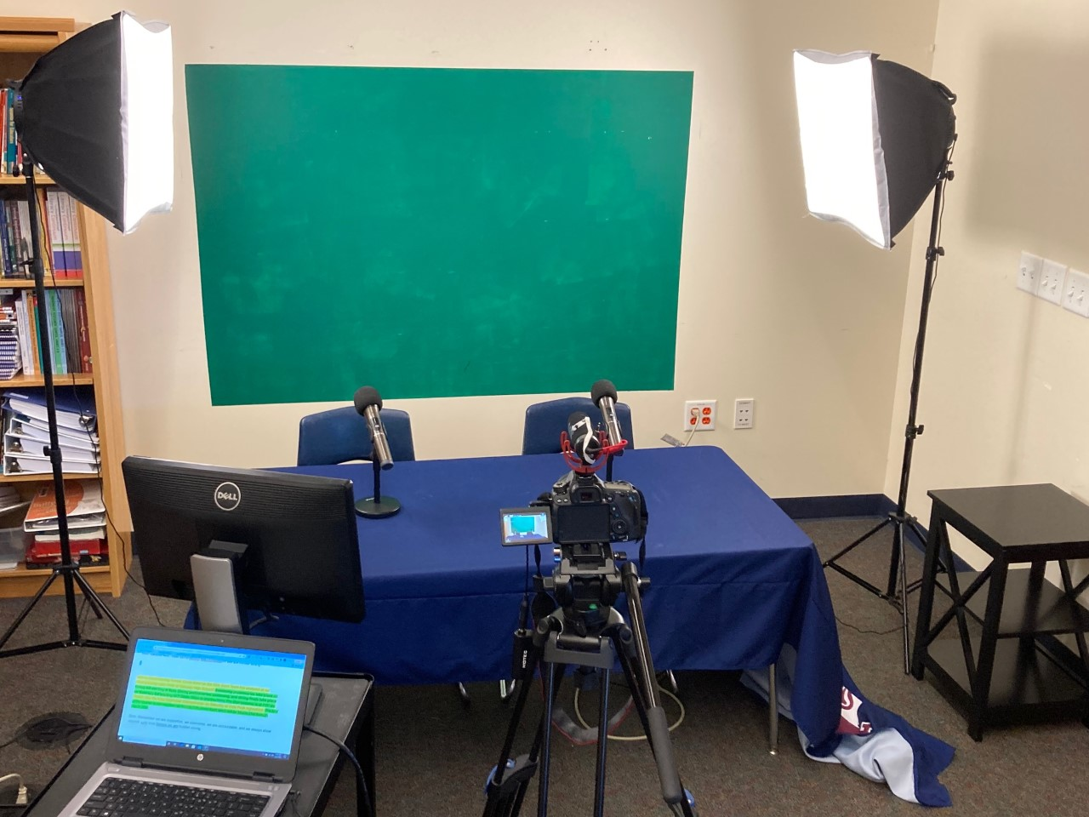
BENEFITS OF DIGITAL PRODUCTION FOR YOUR SCHOOL.

Slide 6
BENEFITS OF DIGITAL PRODUCTION FOR YOUR SCHOOL.
This program brings in multiple Colorado standards as well as national standards.
Literacy is the most apparent standard to incorporate into your lesson planning.
8th Grade Standards for Literacy.
Prepared Graduates:
1. Collaborate effectively as group members or leaders who listen actively and respectfully, pose thoughtful questions, acknowledge the ideas of others, and contribute ideas to further the group’s attainment of an objective.
2. Engage in practical collaborative discussions and analyze the information presented.
Colorado Academic Standards Online (state.co.us)

Slide 7
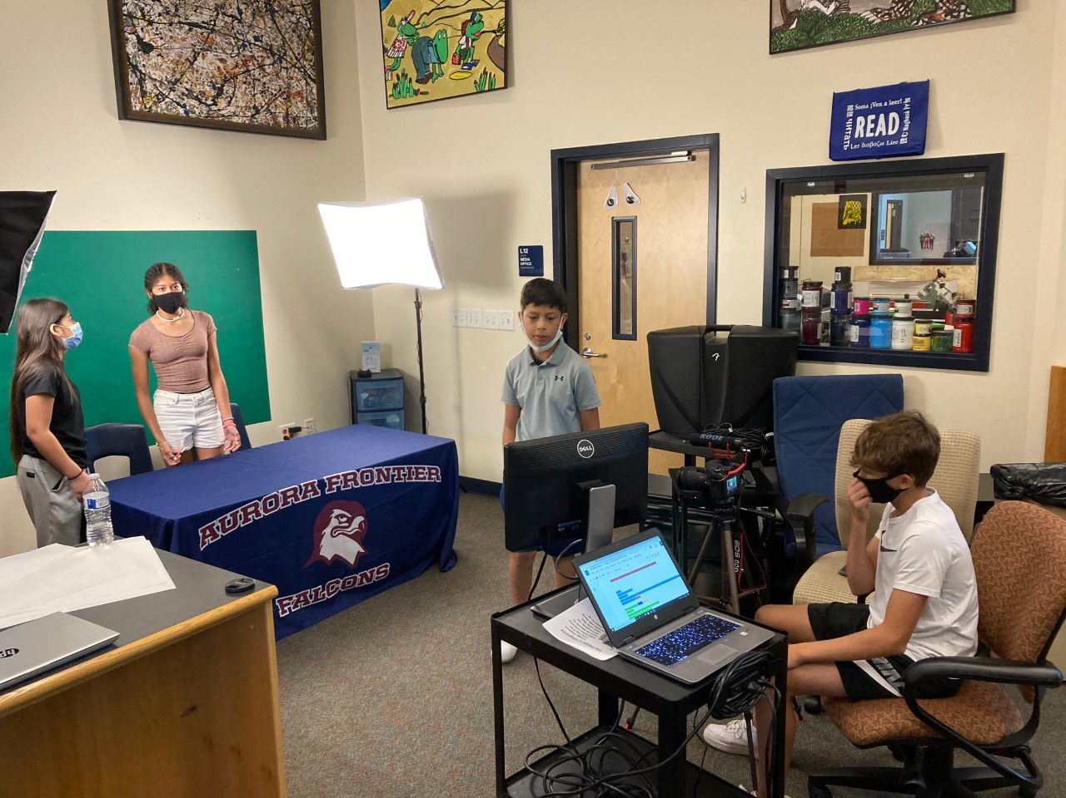
BENEFITS OF DIGITAL PRODUCTION FOR YOUR SCHOOL.
Prepared Graduates:
2. Deliver effective oral presentations for varied audiences and varied purposes.
2. Design organized presentations incorporating key details and claims while tailored for purpose and audience.

Slide 8
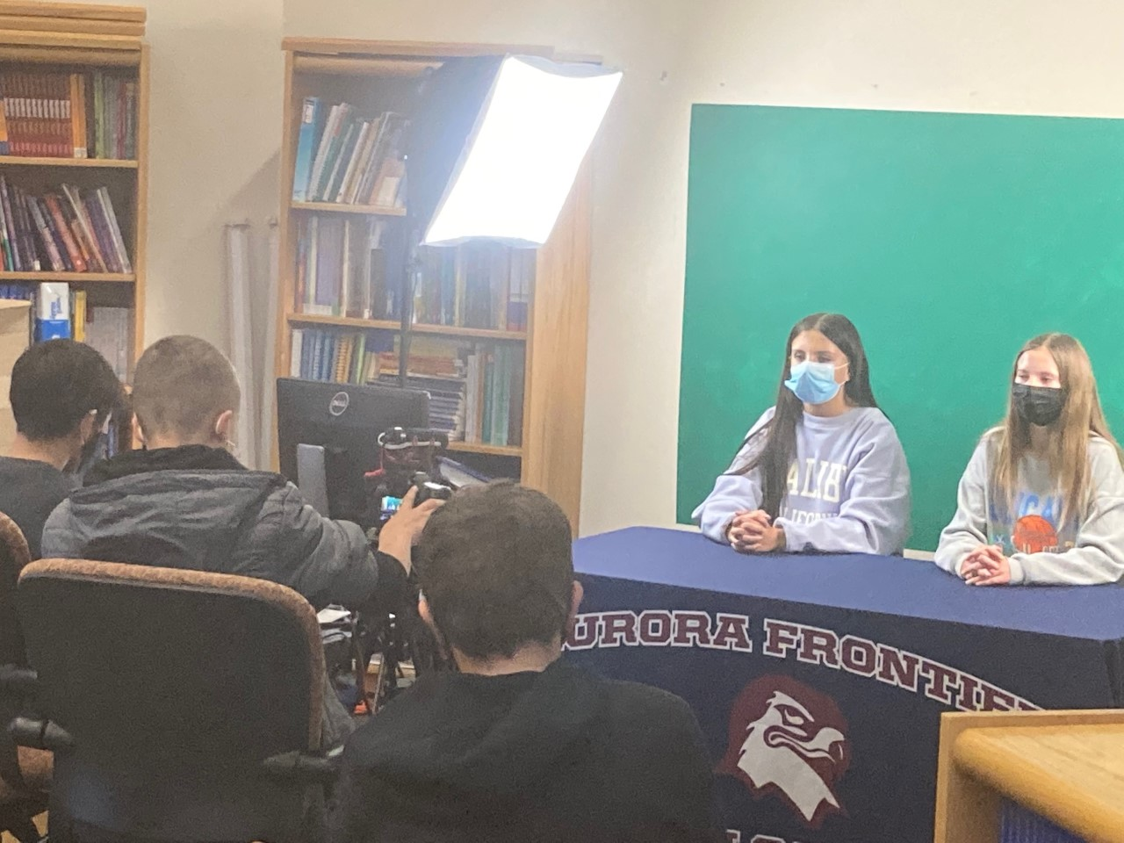
BENEFITS OF DIGITAL PRODUCTION FOR YOUR SCHOOL.
5. Understand how language functions in different contexts, command a variety of word-learning strategies to assist comprehension, and make effective choices for meaning or style when writing and speaking.
5. Apply knowledge of word structure, grammar, and context to determine the meaning of new words and phrases in increasingly complex texts.

Slide 9
BENEFITS OF DIGITAL PRODUCTION FOR YOUR SCHOOL.
Prepared Graduates:
7. Craft informational/explanatory texts using techniques specific to the genre.
2. Write well-developed and logically organized informative/explanatory texts, conveying relevant content through precise language, domain-specific vocabulary, and formal style.
9. Demonstrate mastery of their own writing process with clear, coherent, and error-free polished products.
4. Produce clear and coherent final drafts that demonstrate a command of the conventions for grammar, usage, and mechanics as well as a style appropriate to task, purpose, and audience.

Slide 10
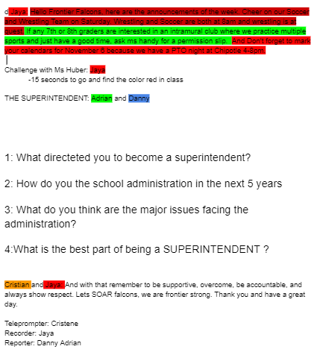

Slide 11
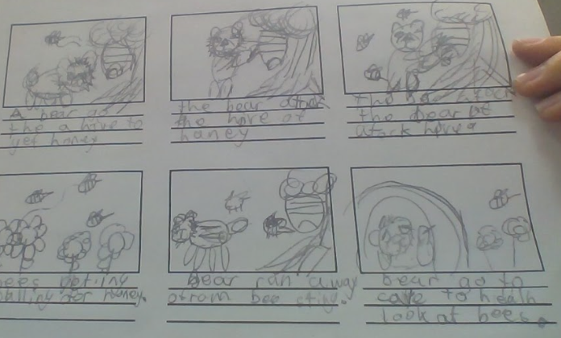

Slide 12
BENEFITS OF DIGITAL PRODUCTION FOR YOUR SCHOOL.
ISTE Technology Standards.
1.1 Digital Citizen. Students recognize the rights, responsibilities and opportunities of living, learning and working in an interconnected digital world, and they act and model in ways that are safe, legal and ethical.
1.2.a- Students cultivate and manage their digital identity and reputation and are aware of the permanence of their actions in the digital world.
1.2.b- Students engage in positive, safe, legal and ethical behavior when using technology, including social interactions online or when using networked devices.
1.2.c- Students demonstrate an understanding of and respect for the rights and obligations of using and sharing intellectual property.
1.2.d- Students manage their personal data to maintain digital privacy and security and are aware of data-collection technology used to track their navigation online.
ISTE Standards

Slide 13
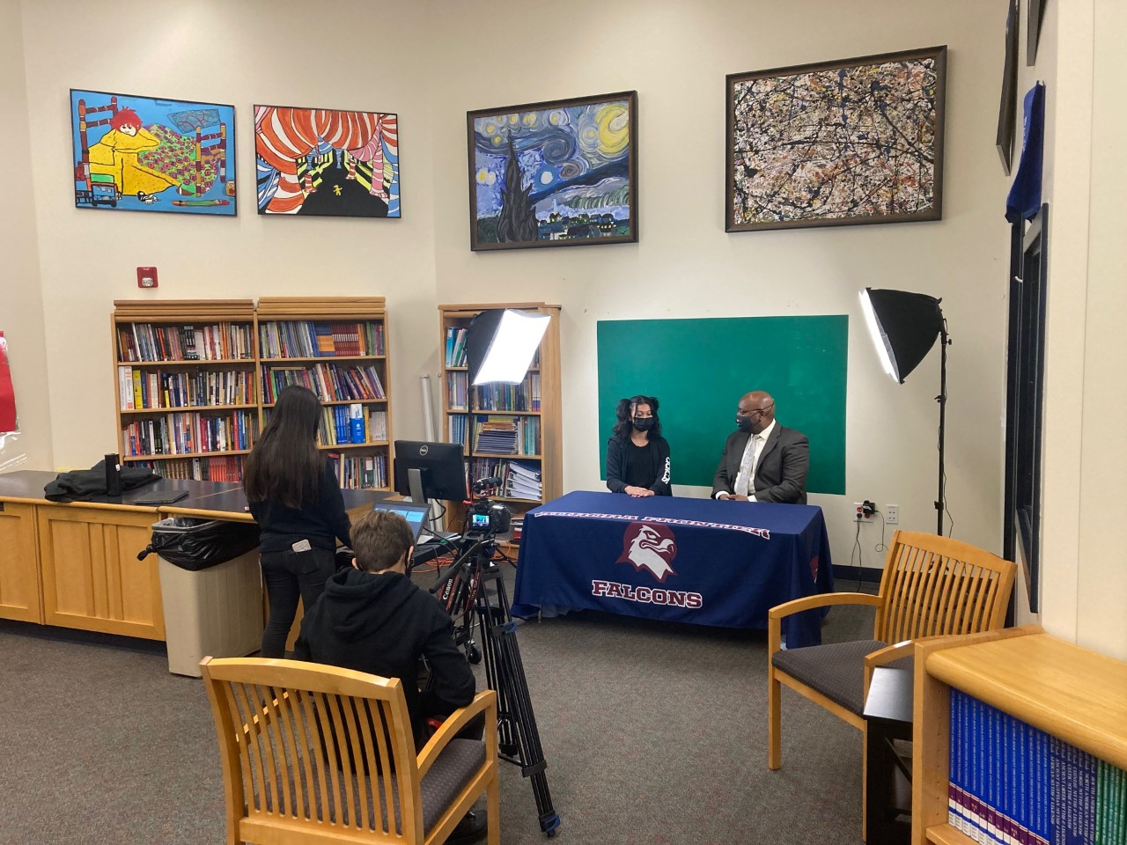
BENEFITS OF DIGITAL PRODUCTION FOR YOUR SCHOOL.
ISTE Technology Standards.
1.6 Creative Communicator. Students communicate clearly and express themselves creatively for a variety of purposes using the platforms, tools, styles, formats and digital media appropriate to their goals.
1.6.a- Students choose the appropriate platforms and tools for meeting the desired objectives of their creation or communication.

Slide 14
BENEFITS OF DIGITAL PRODUCTION FOR YOUR SCHOOL.
1.6.b- Students create original works or responsibly repurpose or remix digital resources into new creations.
1.6.c- Students communicate complex ideas clearly and effectively by creating or using a variety of digital objects such as visualizations, models or simulations.
1.6.d- Students publish or present content that customizes the message and medium for their intended audiences.
ISTE Standards

Slide 15
BENEFITS OF DIGITAL PRODUCTION FOR YOUR SCHOOL.
Students can work by themselves, in pairs, or as a team.
This program allows students to take on many different roles or focus on one job they feel the most comfortable with.
Students can choose how they can best participate and showcase their interests.
Digital Natives feel like they understand this form of expression because they have grown up on social media.

Slide 16
BENEFITS OF DIGITAL PRODUCTION FOR YOUR SCHOOL.
The Digital Production course works because the entire class needs to be apart of the production.
Students can be in front of the camera or behind the camera.
Many different interests can be shared throughout the course while very necessary information can be shared on a regular basis.
It allows the school to feel more connected between the classes and grade levels.

Slide 17
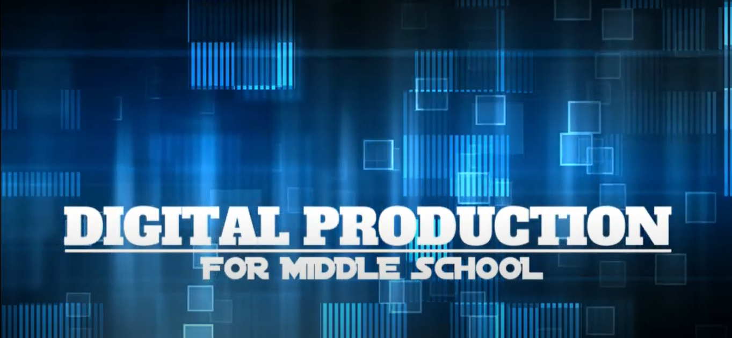
DIGITAL PRODUCTION NEWSCAST.
How to teach Digital Production
https://youtu.be/6G42l3BEpl4

Slide 18
DIGITAL PRODUCTION NEWSCAST.
Weekly Production for a newscast. Monday.
Start with: What events are going on in the school for the next week.
  Are there sporting events, exams, holidays or special events coming up?
  Is there a fundraiser or PTO function that students need to know about?
  Do you have after school clubs, concerts or activities that need to be shared?
Does the school do a Pledge of Allegiance or a motto that everyone says at the start of the day?

Slide 19
DIGITAL PRODUCTION NEWSCAST.
What kind of interviews are the students interested in doing?
  Interview the administration or important support staff that the students see every day.
What teachers do the students want to know more about?
Are there interviews with students who have won something or opinions that the school wants to talk about (keep it light)?
Don’t be afraid to interview community leaders or people in the district.

Slide 20
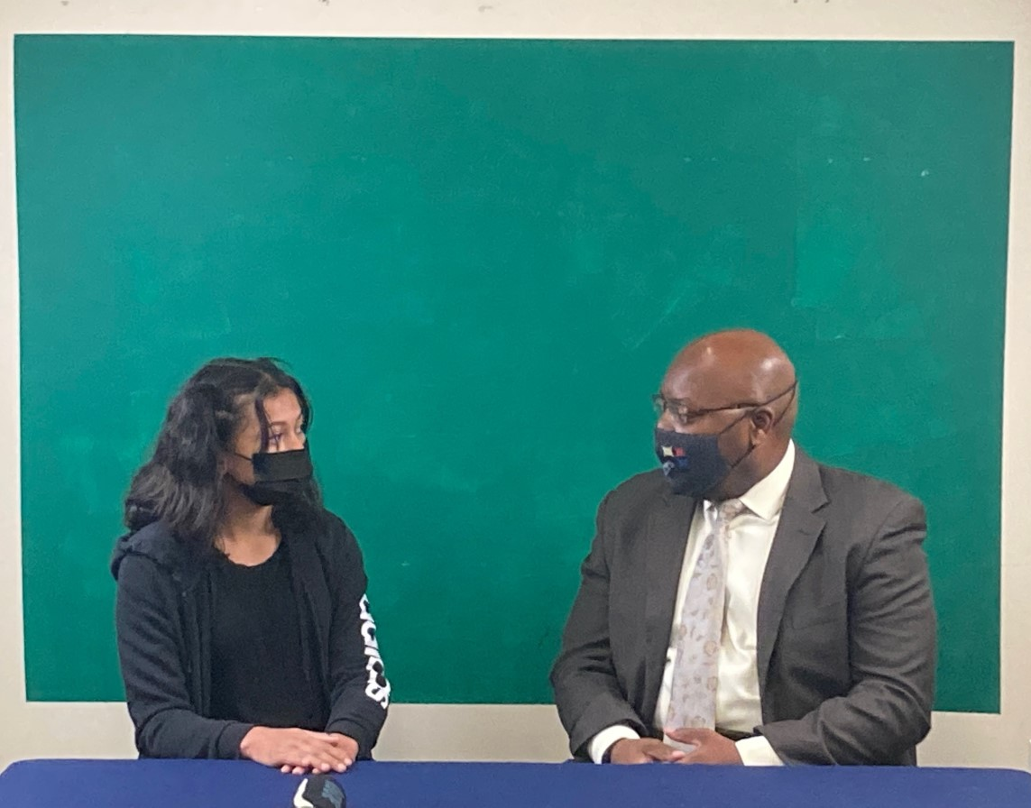
DIGITAL PRODUCTION NEWSCAST.

Slide 21
DIGITAL PRODUCTION NEWSCAST.
Start writing scripts for each persons specific job.
Anchors will give general information.
Reporters need to write questions that they will share before the interview. Be sure to get permission first from all involved.
Depending on schedules this should be done in the first day or days of the week. Example: Monday and Tuesday.
Have all work turned in for approval before going in front of a camera.

Slide 22
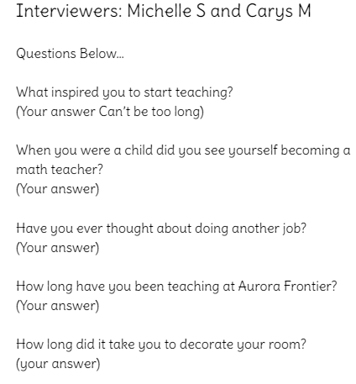
DIGITAL PRODUCTION NEWSCAST.

Slide 23
DIGITAL PRODUCTION NEWSCAST.
Day of Recording. (Wednesday)
You will need a desk for the anchors to be behind. Use regular chairs that force the students to sit up straight and no wobbling, bending or moving.
Use to lighting systems on either side of the anchors. This helps with green screen and for them both to be well lit.
Use a good microphone that attaches to the camera or wireless microphones for the anchors to use when recording.

Slide 24
DIGITAL PRODUCTION NEWSCAST.
Day of Recording.
If possible use a computer monitor and a computer on a cart as your teleprompter.
You can plug a monitor into a dedicated laptop with the monitor facing the anchors and the laptop can be operated by a student behind the camera.

Slide 25
DIGITAL PRODUCTION NEWSCAST.
Day of Recording.
The camera can be of any digital kind but DSLR cameras are typically the best option.
Use a tripod that is sturdy, and preferably has a handle for easy movement as well as adjustments.

Slide 27
DIGITAL PRODUCTION NEWSCAST.

Slide 28
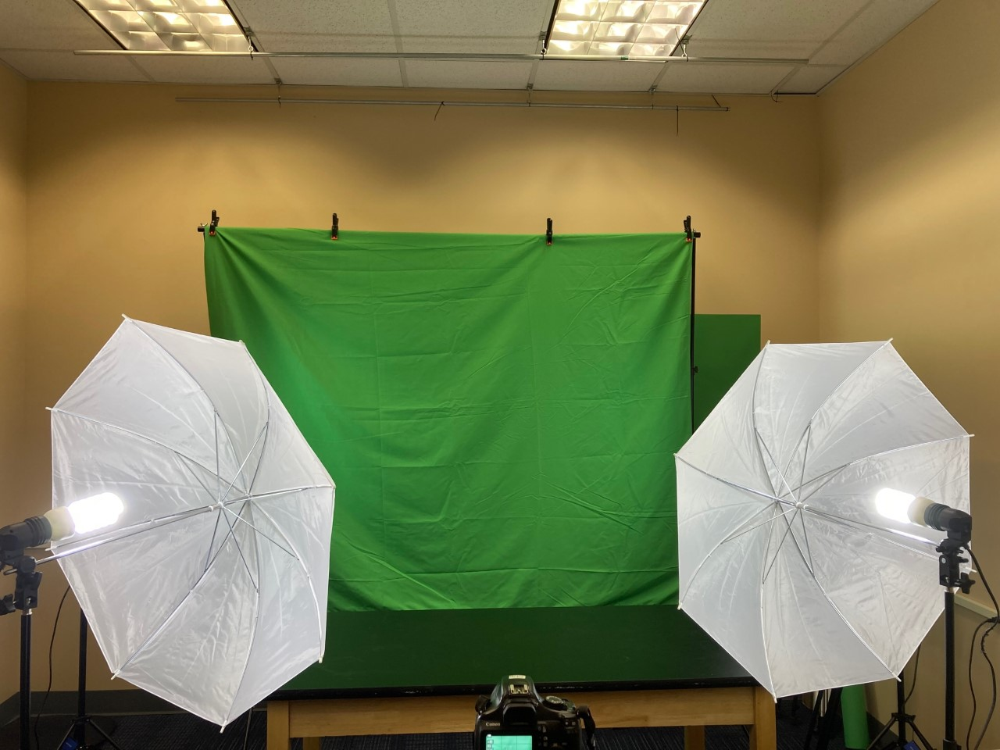
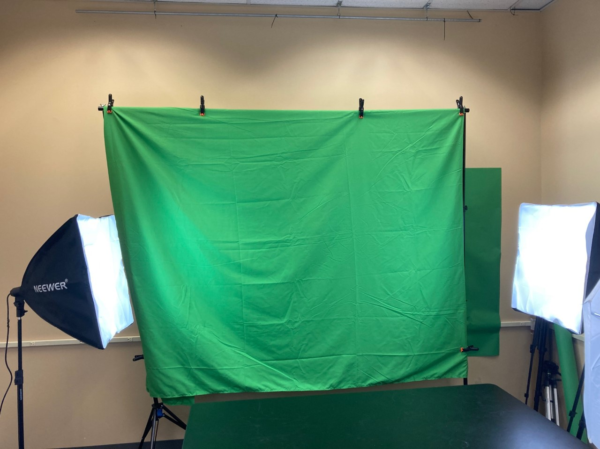
SIMPLE SETUP FOR A LOW-BUDGET CLASS.

Slide 29
DIGITAL PRODUCTION NEWSCAST.
It is always good to have everyone practice at least once to get a feel for the weeks newscast.
Be ready for lots of mistakes and retakes. A five minute video may take 30 minutes to record. (It’s a good idea to have the camera operator to delete and video that wont be used).
All of the video is considered raw footage until it is edited.
Students who are doing other interviews around the campus will be required to either share the video through a program like Google Classroom, or you will have to upload their footage to Goggle Classroom.

Slide 30
DIGITAL PRODUCTION NEWSCAST.
Editing Day(s) Wednesday / Thursday.
All of the videos need to be upload from the camera to a program that all of the students can use and access. Google Classroom allows students to share large digital files and download them to their own devices.
The editor(s) need to adjust the video to get rid of wasted dead space, add visuals, add sound ( background music, etc.).
Add green screen elements like images behind the anchors.

Slide 31
DIGITAL PRODUCTION NEWSCAST.
Editing Day(s) Wednesday / Thursday.
Once all of the raw footage is edited the editors must arrange the videos into one file that is ready to be shared. Use MP4 format in most cases.
Once the final video is done you can share the video in several methods.
Using Google Sites the video can be uploaded to the schools website. If the school uses a YouTube account the video can be shared from this site. Most MP4’s can be shared through most digital platforms.

Slide 32
DIGITAL PRODUCTION NEWSCAST.
Broadcast Day. Friday.
With most broadcast needing to be seen first thing in the morning it is best to upload your video the night before. It may take awhile for the video to process and you will need a link that works to share with others.
Send out a school wide email with a link with the video to the staff, and make sure it is a shared file.

Slide 33
FILM FESTIVAL OPTIONS
Have students develop a video for multiple categories for your own film festival.
Throughout the course, students can work on television themes, movies, or social media.

Slide 34
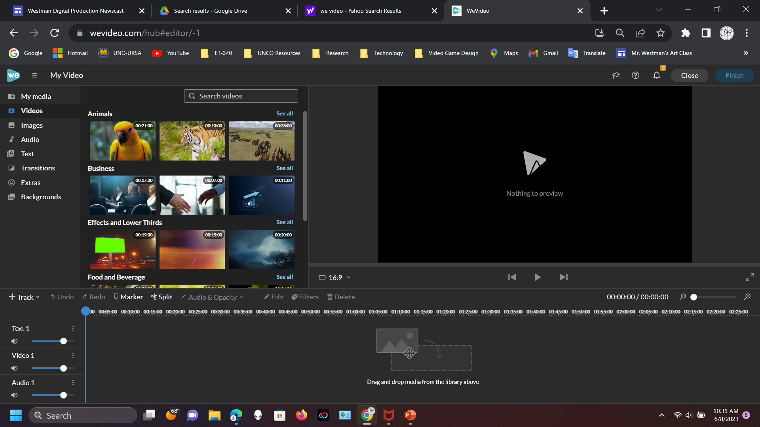
TYPES OF VIDEO PRODUCTIONS.
WeVideo – On Line digital editing software.
https://www.wevideo.com/

Slide 35
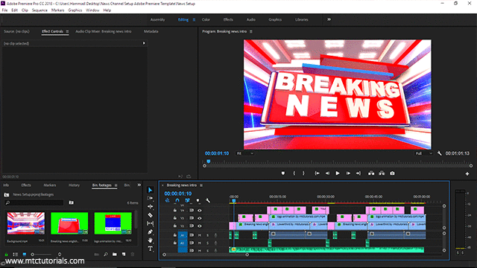
TYPES OF VIDEO PRODUCTIONS.
Adobe Premiere – On Line digital editing software.
This Photo by Unknown Author is licensed under CC BY-NC
https://www.adobe.com

Slide 36
Q&A
What do you want to ask?

Slide 37
BRYAN WESTMAN
Bryan.Westman@unco.edu
https://www.linkedin.com/in/bryan-westman-42818382
Website or QR Code to the website with all of the
resources and presentation.
https://sites.google.com/view/westmandigitalproduction

Slide 38
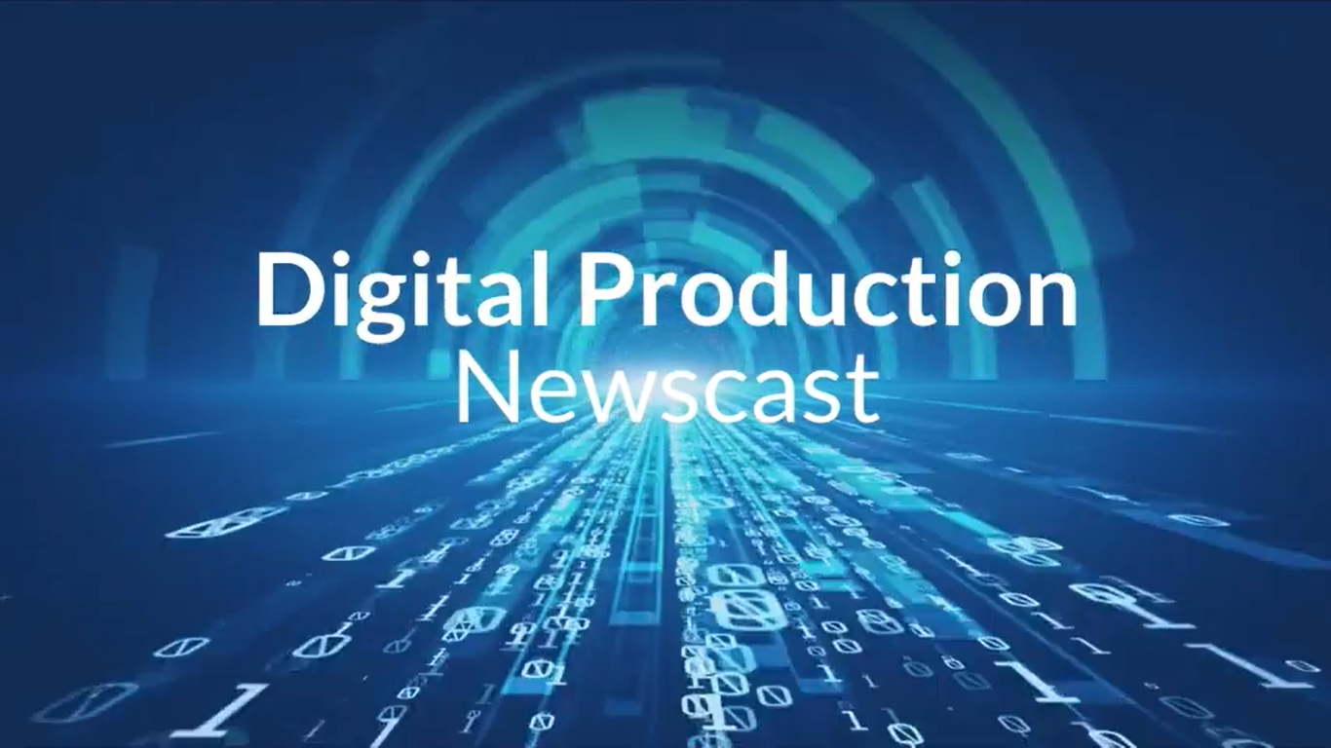
STUDENT NEWSCAST PROMOTION
Students made a promotional video for future students to sign up for the Digital Production class.
Join the School News
https://youtu.be/UbpmwQ9eEiM
School Newscast Video
Interview with Superintendent

Slide 39
THE END
Thank you.

